Slide 1
Urban & Rural Vegetation
Caiyi Zhong

Slide 2
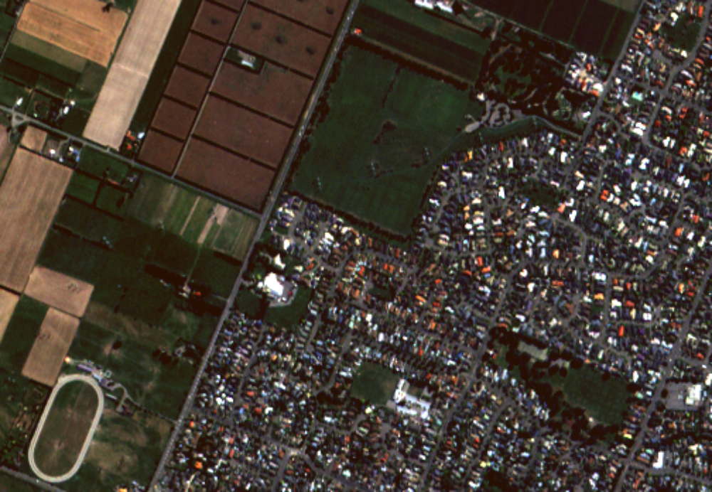
Task
Urban Veg.
Rural Veg.

Slide 3
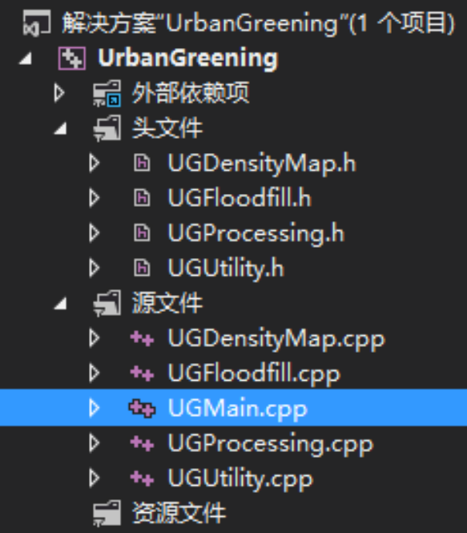
Data & Tools
Softwares
  Intergraph ERDAS Imagine 2013
  Microsoft Visual Studio 2012
Tools
  GDAL
    Geospatial Data Abstraction Library
    Built with C++

Slide 4
Steps / Methodology
Supervised/Unsupervised Classification
Preprocessing
  Remove shadow
  Create urban density map
Further Classification
  Classify Urban/Rural Vegetation

Slide 5
Steps / Methodology
Supervised/Unsupervised Classification
Preprocessing
  Remove shadow
  Create urban density map
Further Classification
  Classify Urban/Rural Vegetation

Slide 6
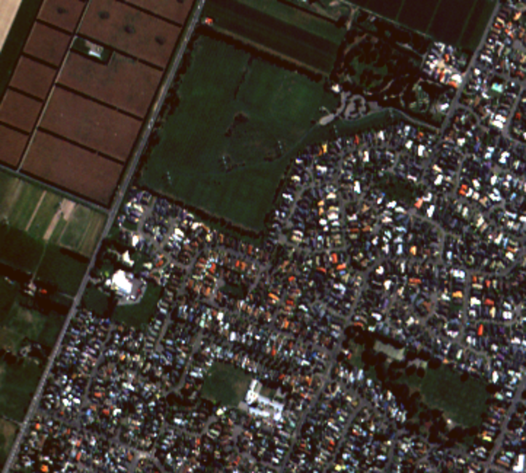
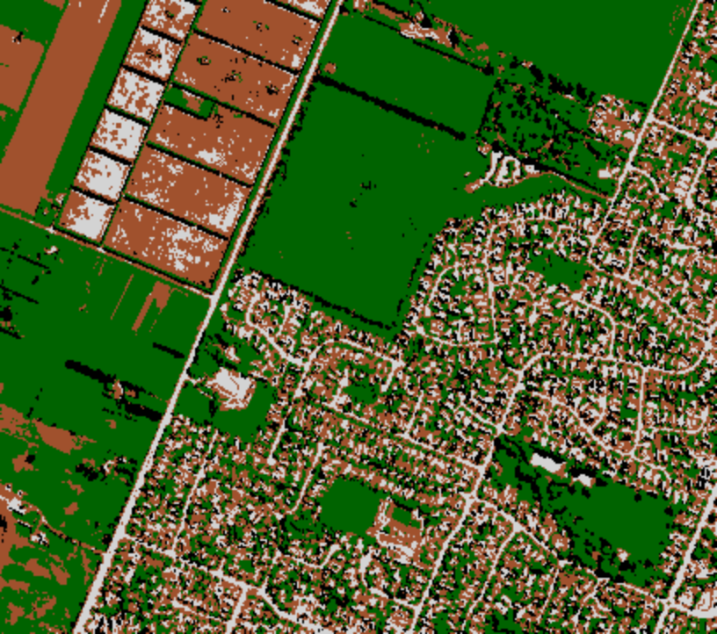
Classification
We got shadows
And in this step, all vegetations are the same

Slide 7
Steps / Methodology
Supervised/Unsupervised Classification
Preprocessing
  Remove shadow
  Create urban density map
Further Classification
  Classify Urban/Rural Vegetation

Slide 8
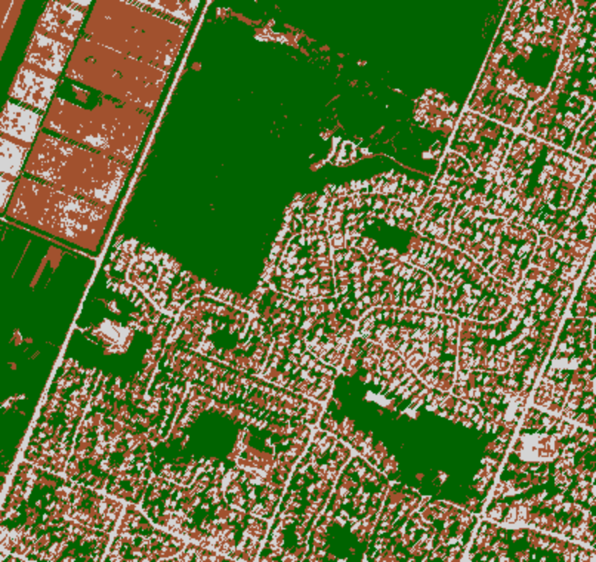
Preprocessing: Remove shadow
Removing Shadows

Slide 9
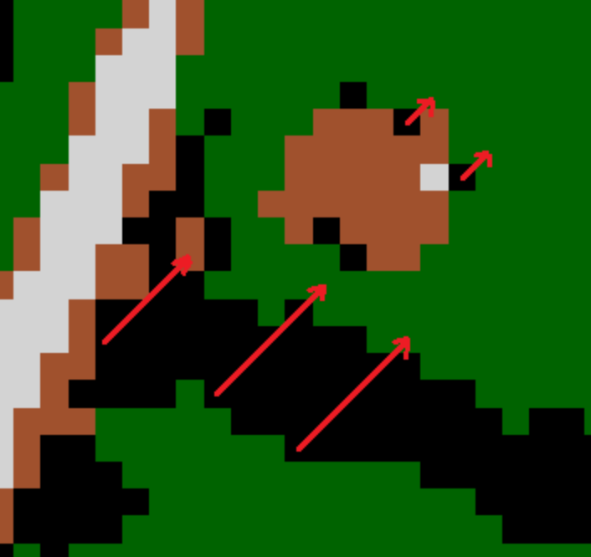
Preprocessing: Remove shadow
Method to remove shadows
8-Directions shadow removing
e.g. Northeast

Slide 10
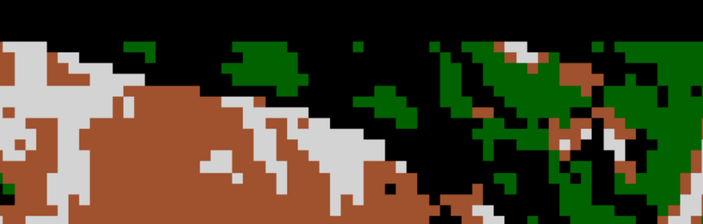
Preprocessing: Remove shadow
Issues
  Image border
    Solution: Just ignore it!

Slide 11
Steps / Methodology
Supervised/Unsupervised Classification
Preprocessing
  Remove shadow
  Create urban density map
Further Classification
  Classify Urban/Rural Vegetation

Slide 12
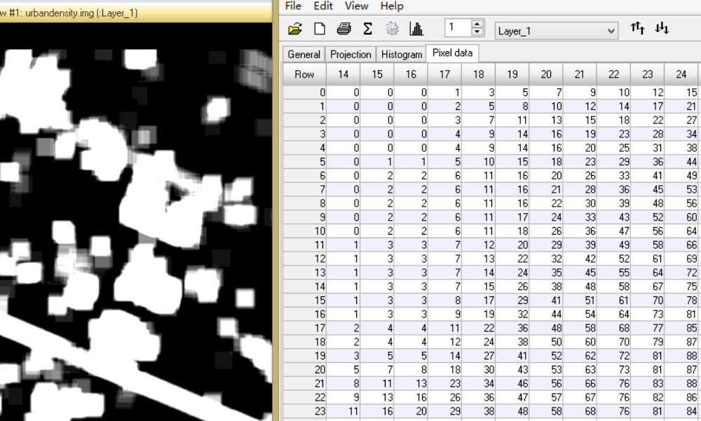
Preprocessing: Urban density map
Just call it UDM

Slide 13
Steps / Methodology
Supervised/Unsupervised Classification
Preprocessing
  Remove shadow
  Create urban density map
Further Classification
  Classify Urban/Rural Vegetation

Slide 14
Classifying Rural/Urban Vegetation
Characteristics of urban vegetation area
  Relatively small area
  Surrounded by urban area completely

Slide 15
Classifying Rural/Urban Vegetation
Algorithm
  1. Scan each vegetation pixel
  2. If it is "in the urban area"
    (That means "in the high density area of UDM")
    If it is small enough, then floodfill it as urban vegetation
    Else floodfill it as rural vegetation
  3. Else if it is big enough
    Then floodfill it as rural vegetation
    Else do nothing

Slide 16
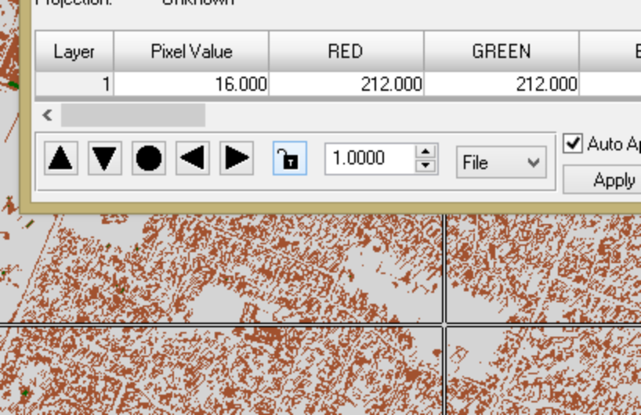
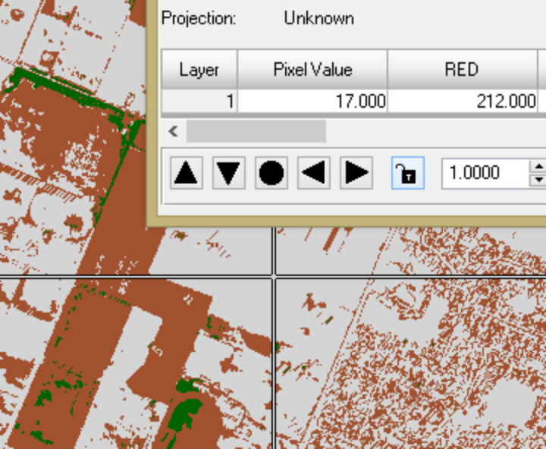
Result
16: Urban
17: Rural

Slide 17
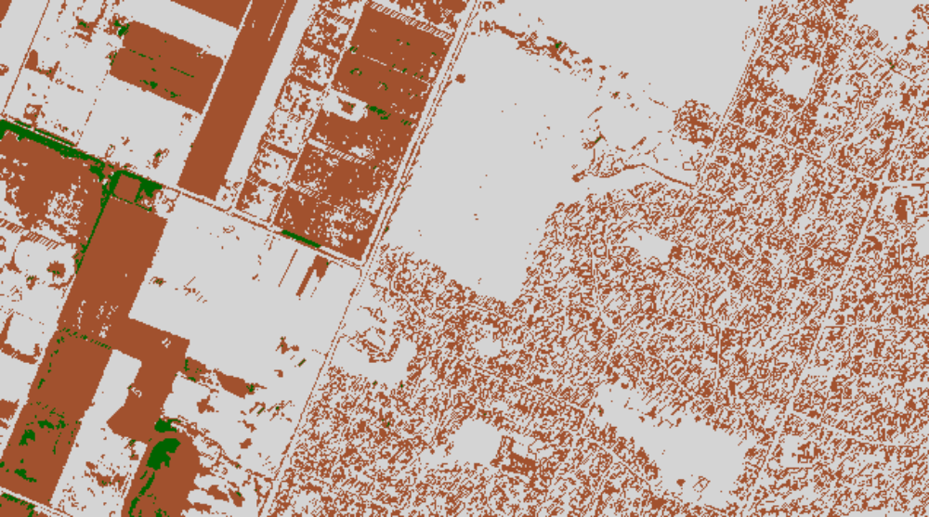
Limitation
WTF!?
Still don't know how to change its color table using GDAL

Slide 18
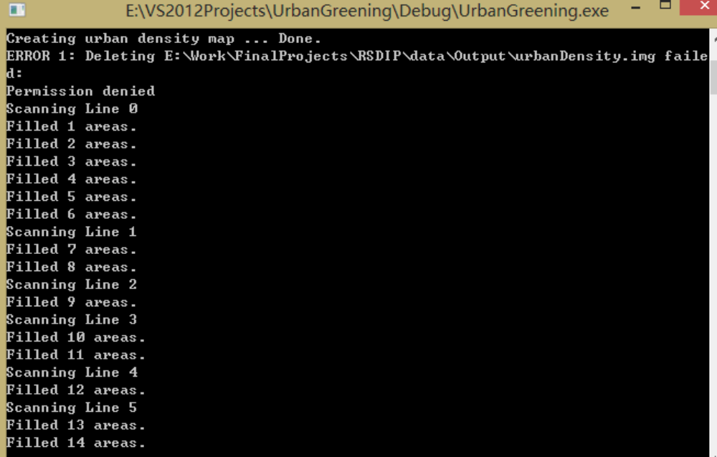
Limitation
Time consuming
Floodfilling is slow
Even I used a relatively quick algorithm

Slide 19
Thank you!
Caiyi Zhong

